Slide 1
Human Activity Detection
  G. Vejey Subash
  Ph.D Scholar
  CS07D004

Slide 2
Agenda
Research problem & its significance
Sub-problems
Related previous work
Proposed work
Conclusion
References

Slide 3
Research Problem
Detecting human activities in a scene
Tracking, identifying & recognising the movements of humans from the videos
  Who is in the scene?
  What is he doing?
  How many people are there in the scene?
  What is the identity of each person?
  Were this person been here before?
  If so when is the last time he was here?

Slide 4
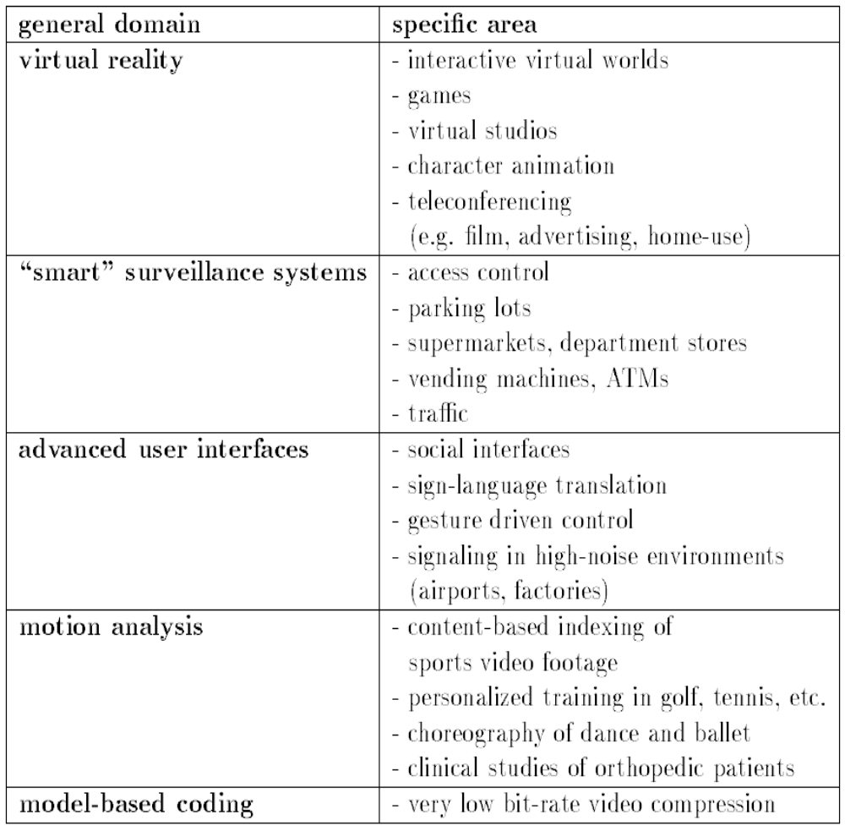
Applications
Courtesy: Visual Analysis of human movements: A survey, D.M. Gavrila

Slide 5
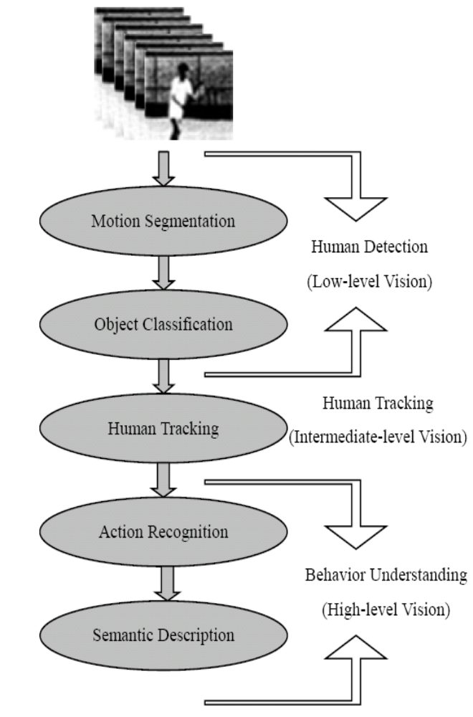
Sub-problems
Human body part detection
Human Tracking
Human Action recognition

Slide 6
Steps involved
Human detection
  Segmenting regions corresponding to people from the rest of the image
Human tracking
  Establishing coherent relations of image features across frames
Human behavior understanding
  Analyse and recognise human motion patterns to produce high-level description of actions

Slide 7
Human Detection
Background subtraction
  Differ in type of background model and procedure used to update the model
    Median value (Yang & Levine [2])‏
Statistical Methods
  Uses the characteristics of pixels for model
    Gaussian mixture (Stauffer & Grimson [3])‏
Temporal Differencing
  Pixel-wise difference between consecutive frames
    Abs diff + threshold + connected component (Lipton [4])‏
    Hybrid ( BS + 3-frame TD )‏

Slide 8
Human Tracking
Model-based tracking
  Stick figure
    Combination of line segments linked by joints
    Median axis Transform
  2D contour
    Human body projection in image plane
    Skeletonisation (Fujiyoshi & Lipton [6])‏
Region-based tracking
  Identify a moving region and track it over time
    Body blobs + gaussian models of human & background ( Wren [7])
Active contour-based tracking
  Bounding contour of object and track and update it over time
    Contours -> STV -> Action sketches (Yilmaz & Shah [8])
Feature-based tracking
  Features like points, lines are extracted and tracked across time
    Bounding box centroid (Polana & Nelson[9])‏
    Corner points of moving silhouettes (Segen & Pingali [10])‏

Slide 9
Human Action Recognition
Understanding behavior
Time-varying feature matching problem
  Dynamic Time Warping (DTW)‏
    Template-based dynamic programming matching
    Handles inconsistent time scales but time ordering constraints
  Hidden Markov Model(HMM)‏
    Stochastic state machine
    Training : # states, state transition and output probabilities are optimised
    Matching: Given image sequences, find the probability that HMM generates test symbol sequence corresponding to observed image features
  Support Vector Machines (SVM)‏
  Self-Organising Neural Network(SONN)‏
    Unsupervised

Slide 10
Human Detection
Video Image
Background Image
Thresholding
Motion Image
Filtering
Cleaning of blobs
Non-noisy image
Dilation / Erosion
Blob
Bounding Box
Bound Blobs
Proximity analysis
Region
Head Detector
Head region

Slide 11
Identity Tracker
  Input: Blobs with bounding box from motion detector
  Output: Tracked blobs with its trajectory
  Compute histogram of the blob.
  Correlate with the histograms of all the models available.
  Find the maximum value of the correlation results.
  If maximum value is less than a threshold
    Add a new model with the histogram of blob to the available list.
    Else
    Mark the blob as belonging to the corresponding model having maximum correlation value.
  Compute the centroid of the blob and keep track of the blobs’ trajectory.
  Get the blobs of the next frame from motion detector.

Slide 12
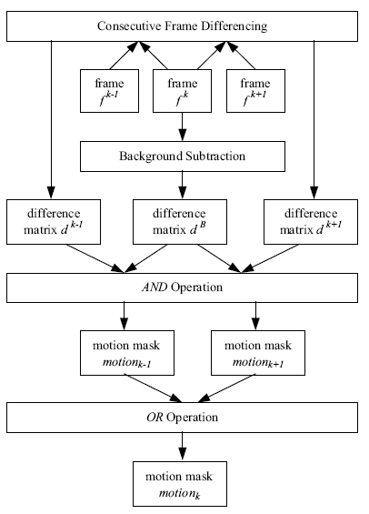
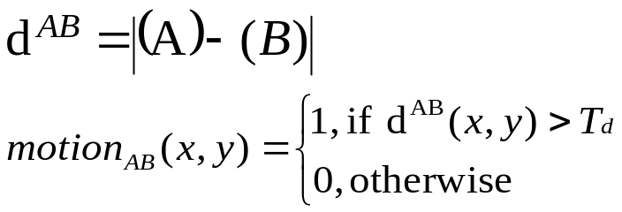
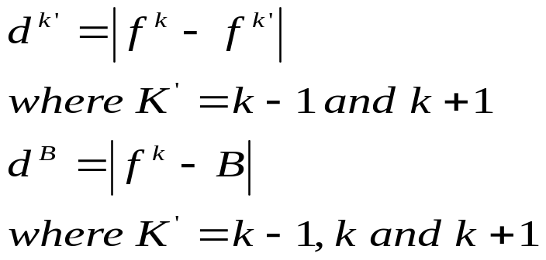
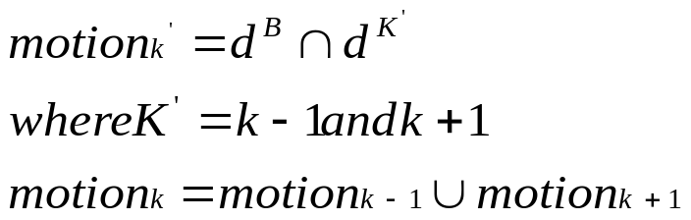
Combined BS-TD method
Difference Image

Slide 13
Histogram Modeling
Histogram_{index} = ( red / 32 ) + 8 * ( green / 32 ) + 64 * ( blue / 32 )‏
Parameters
Bins
distance measures
Greater the bin size, greater the accuracy and higher the computation

Slide 14
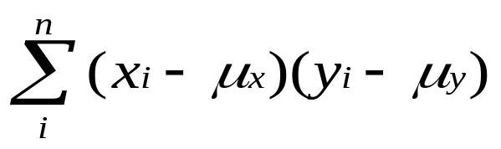
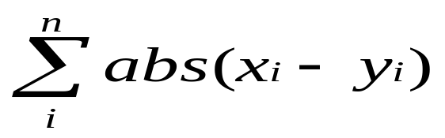
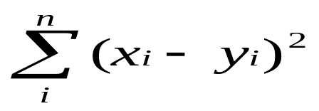
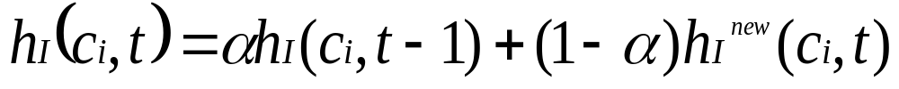
Model equations
Distance Measures
Model Updation equation

Slide 15
Blob / Model
Subash
Vasanth
Arjun
Jayaram
Subash
13.25
9.69
6.2
3.38
Vasanth
8.8
12.08
5.12
2.78
Arjun
5.88
4.95
11.99
5.8
Jayaram
3.57
2.88
5.86
11.58
Confusion matrix of the Correlation sum of the histograms
Models
Color of the model
1
Red
2
Black
3
White
4
Green
5
Yellow
6
Cyan
7
Magenta
Lookup table for coloring of the models

Slide 16
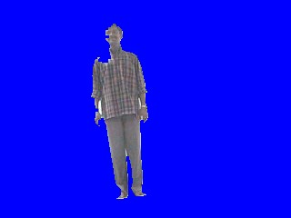
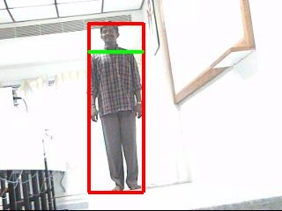
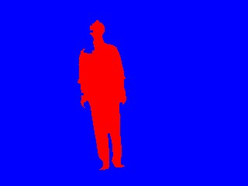
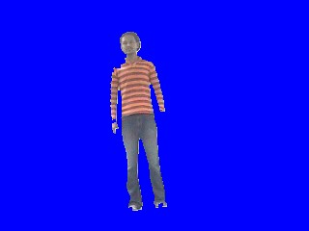
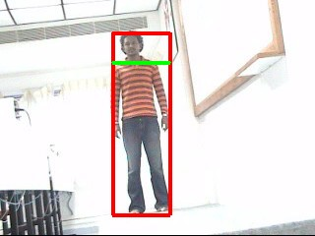
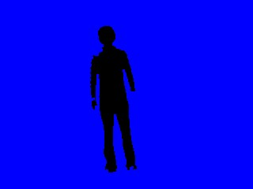
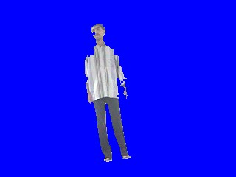
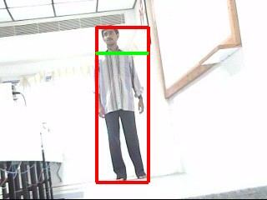
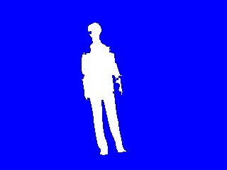

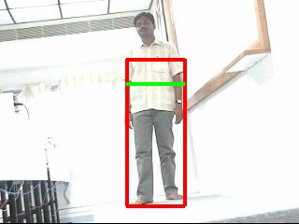
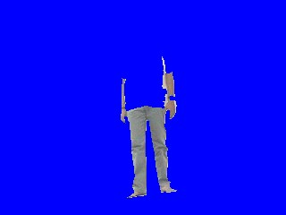
Results
First column -> Blob detected from motion detector module.
Second column -> Bounding Box with red rectangle and head detected with green line.
Third column -> Identity tracker results with different colors for each person colours for each person.
Error in identity detection due to the effect of the background

Slide 17
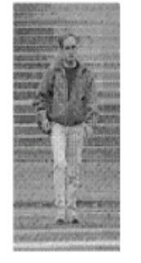



Proposed Work
Human body joints detection
Current frame
Reference frame
Background subtraction
Human Blob
Skin Detector
Circle Detector
Edge Map
ll line Detector
Geometric
Constraints
This design will yield points of interest like head, arms, feet and joints

Slide 18
Skin Detector
Decision rule -> Pixel is skin or not
  What color space to choose
    RGB
    Normalised RGB
    HSV, HSI, HSL
  What skin color distribution model
    Explicit skin-color model
    Look Up Table
    Bayes Classifier
    Mixture of Gaussians

Slide 19
Geometric Constraints
Estimation of pose – configurations of body parts of a human
Geometric ordering
  Upper Left Arm (ULA) => Lower Left Arm(LLA)‏
  Head => Upper Left Arm(ULA)‏
Appearance constraints
  Upper Left Arm = Upper Right Arm
  Lower Left Leg = Lower Right Leg

Slide 20
Tracking
12 feature points are tracked over time
Each point has a trajectory in 3D space
Dataset: Person showing Yoga Asanas
Each Yoga Asanas has a series of poses and definite time ordering constraints as well.

Slide 21
Action recognition
Assumptions
  Each action has a unique trajectory
  Each action in real world is trajectorised in 3D space by feature points detected beforhand
Group of points in 3D space at any time instant – POSE
Each action has several poses
Hidden Markov Model
  Each pose is modeled as hidden state
  Each image sequence are the observations
  Training
    # states, state transition and output probabilities are optimised
  Matching
    Given image sequences, find the probability that HMM generates test symbol sequence corresponding to observed image features

Slide 22
Conclusion
Related literature is presented
Work done so far in “Who is entering the scene” is presented
Body joints detection is proposed with wealth of information ( skin color, edge, geometric constraints )‏
HMMs are the best choice for action recognition problems

Slide 23
References
[1]. D.M. Gavrila, “The visual analysis of human movement: a survey”, Computer Vision and Image Understanding, 73 (1) (1999) 82-98.
[2]. Y.H. Yang, M.D. Levine, “The background primal sketch: an approach for tracking moving objects”, Machine Vision and applications, 5 (1992) 17-34.
[3]. C. Stauffer, W. Grimson, “Adaptive background mixture models for real-time tracking”, Proc. of IEEE CS Conf. on Computer Vision and Pattern Recognition, Vol. 2, 1999, pp. 246-252.
[4]. A.J. Lipton, H. Fujiyoshi, R. S. Patil, “Moving target classification and tracking from real-time video”, Proc. of IEEE Workshop on Applications of Computer Vision. 1998, pp. 8-14.
[5]. I.A. Karaulova, P.M. Hall, A.D. Marshall, “A hierarchical model of dynamics for tracking people with a single video camera”, British Machine Vision Conference. 2000, pp. 352-361.
[6]. H. Fujiyoshi and A. J. Lipton, “Real-time human motion analysis by image skeletonization”, in Workshop on Applications of Computer Vision, 1998.
[7]. C.R. Wren, A. Azarbayejani, T. Darrell, A. P. Pentland, “Pfinder: real-time tracking of the human body”, IEEE Trans. on Pattern Analysis and Machine Intelligence, 19 (7) (1997) 780-785.
[8]. A. Yilmaz, M. Shah, “Actions as objects: A novel action representation”, IEEE Computer Vision and Pattern Recognition 2005
[9]. R. Polana, R. Nelson, “Low level recognition of human motion”. Proc. of IEEE CS Workshop on Motion of Non-Rigid and Articulated Objects Austin, TX, 1994, pp. 77-82.
[10]. J. Segen, S. Pingali, “A camera-based system for tracking people in real time” Proc. of Intl. Conf. on Pattern recognition 1996, pp. 63-67.
[11]. Y. Iwai, K. Ogaki, M. Yachida, “Posture estimation using structure and motion models”, Proc. of International Conference on Computer Vision, Greece, September 1999.
[12]. C. Bregler, J. Malik, “Tracking people with twists and exponential maps”, Proc. of IEEE CS Conf. on Computer Vision and Pattern Recognition, 1998.
[13]. Y. Kameda, M. Minoh, K. Ikeda, “Three-dimensional pose estimation of an articulated object from its silhouette image”, Proc. of Asian Conference on Computer Vision, 1993.
[14]. A. Mohan, C. Papageorgiou, T. Poggio, “Example-based object detection in images by components”, IEEE Trans. On Pattern Analysis and Machine Intelligence, 23 (4) (2001) 349 – 361.

Slide 24
SUGGESTIONS !!
  Thank You

Slide 25
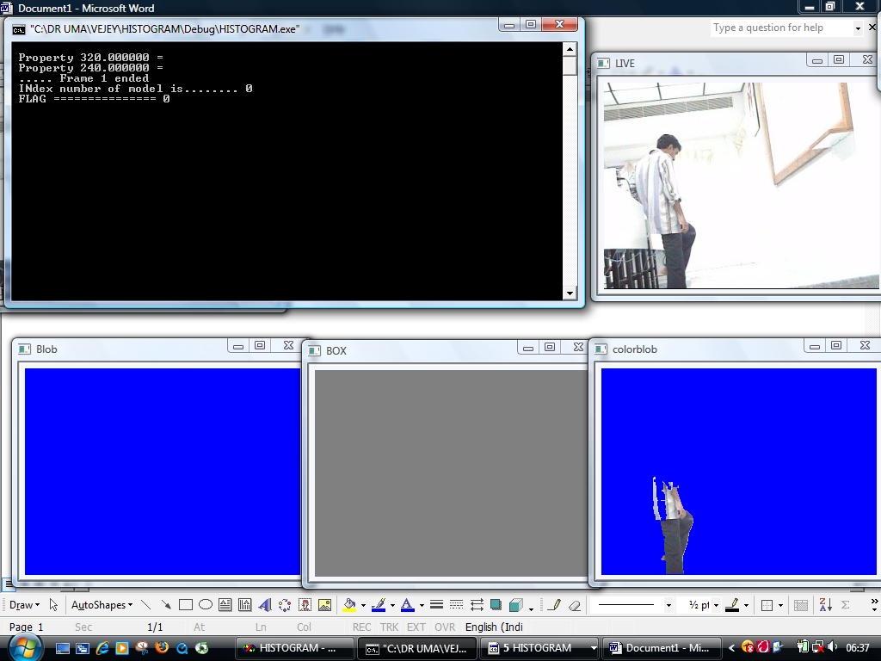
SUPPLEMENTARY RESULTS
Snapshot showing the blob not acquired correctly from the background subtraction module.
This is due to the same nature of colour of his shirt with that of the background.

Slide 26
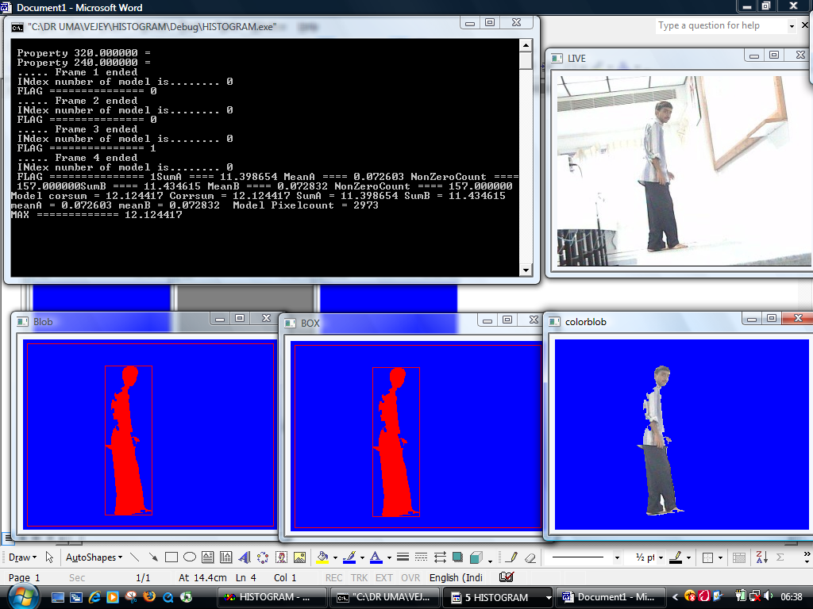
This shows the red coloring of the blob stating this is the first model that arrived.

Slide 27
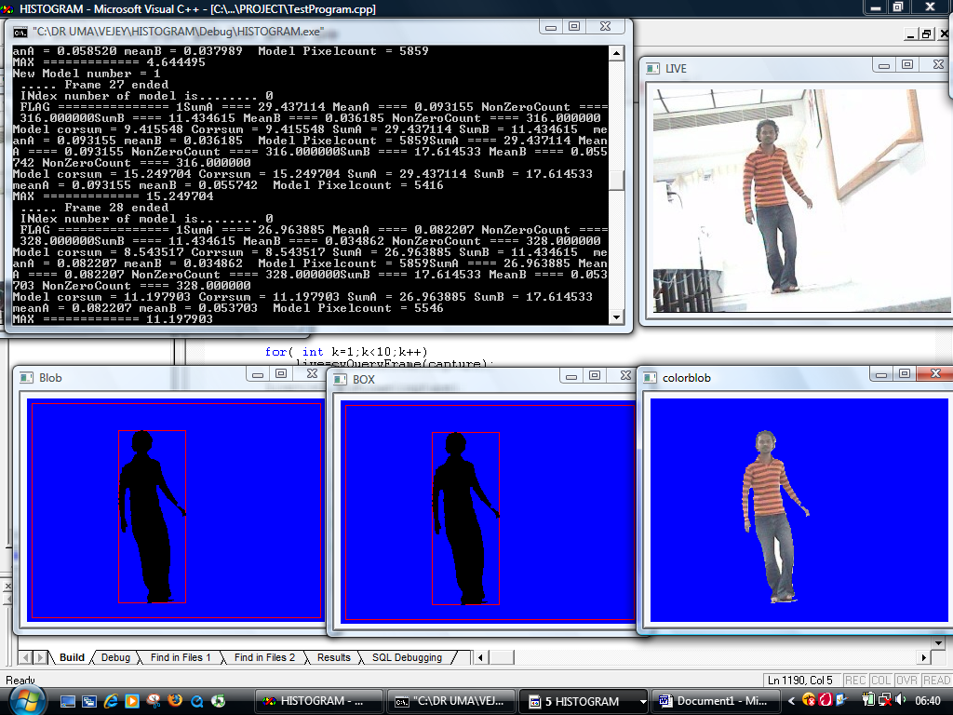
This shows the black color i.e., the second model in the list.

Slide 28
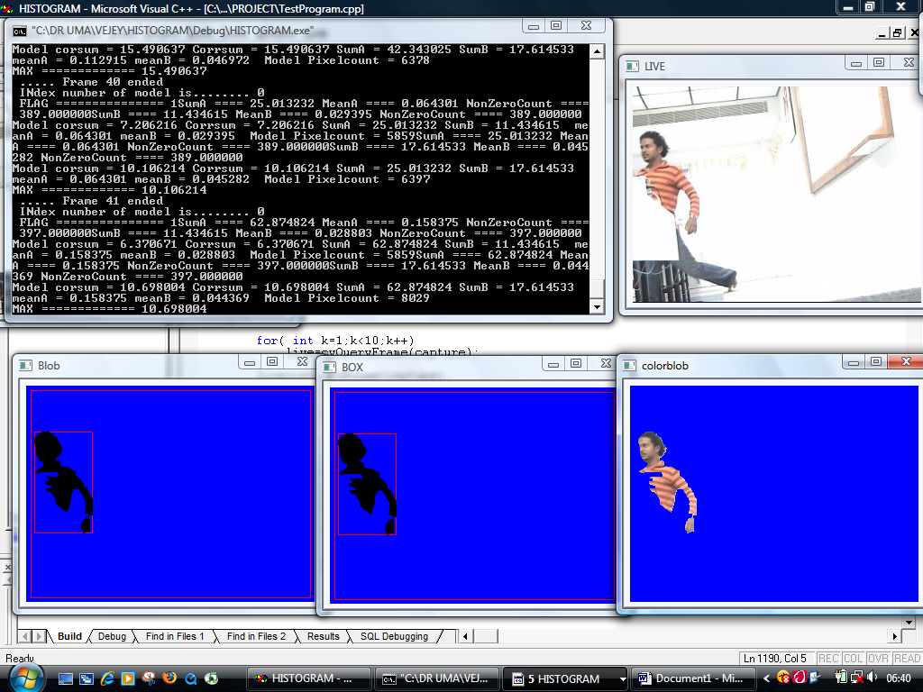
This shows the half blob on the run.

Slide 29
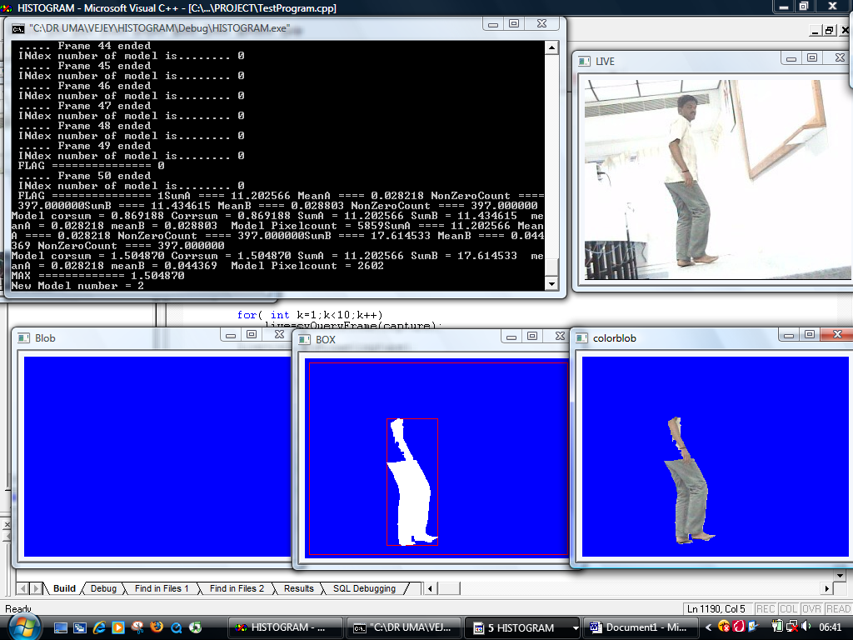
Blob is not correctly acquired because of the same coloring
problem with background.

Slide 30
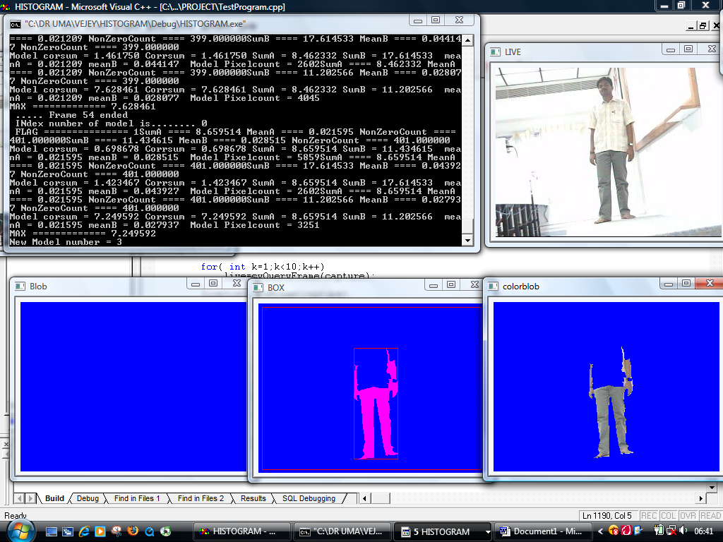
Other models are shown in this snapshot which is false positive.

Slide 31
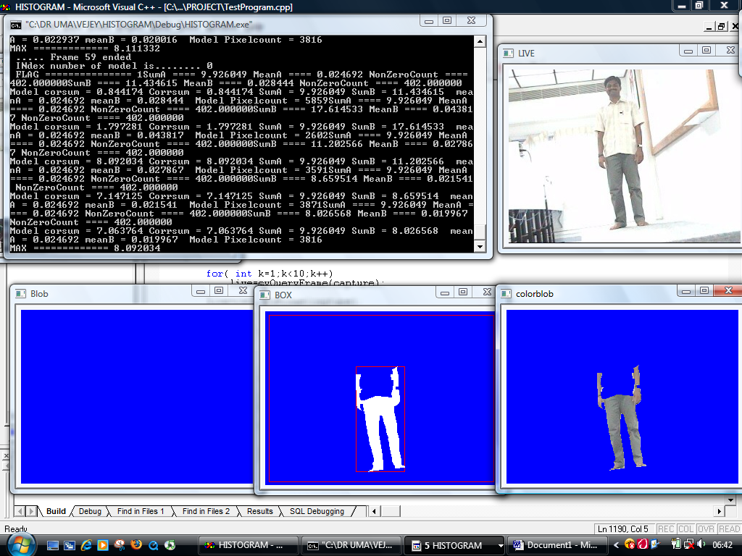

Slide 32
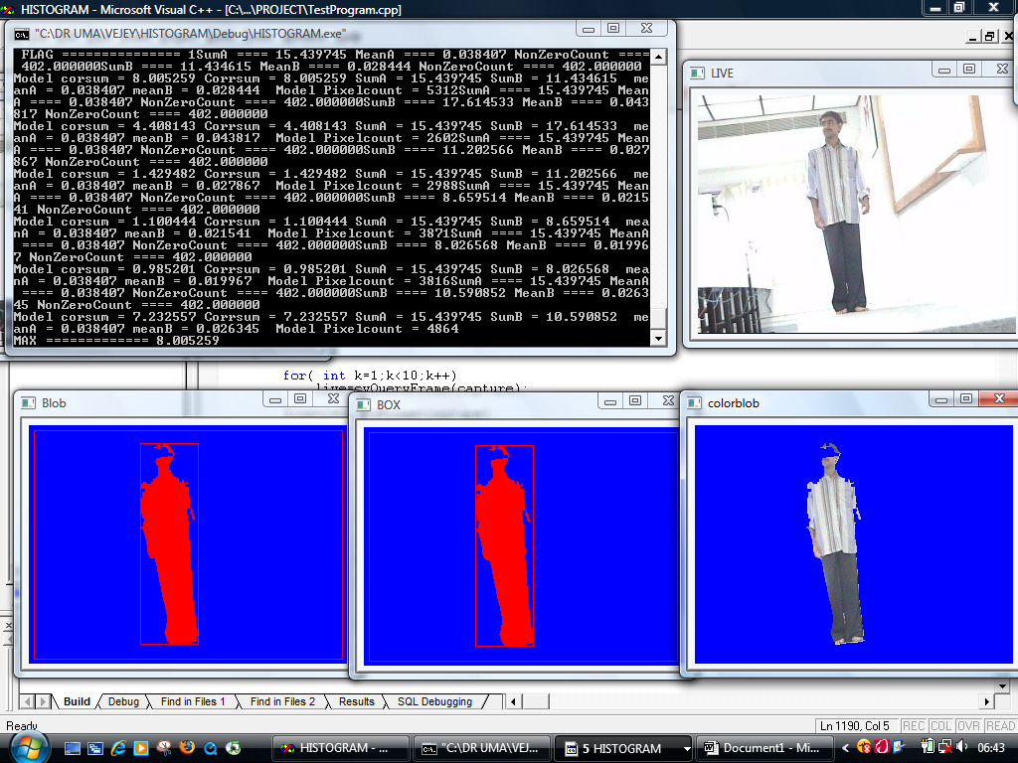
Correct identification of the red color model even when he is
entering after sometime.

Slide 33
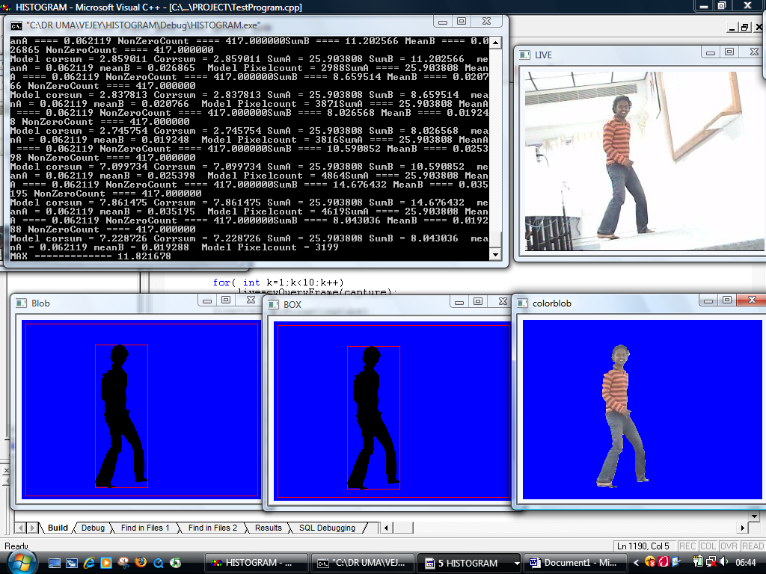
Correct identification of the black color model the second time
he enters the scene.

